Slide 1

Docker to the Security

Slide 2






Who Am I?

Slide 3
Containerisation
Not a VM*
Operating System level segmentation
Namespaces
Process isolation
File system isolation

Slide 4
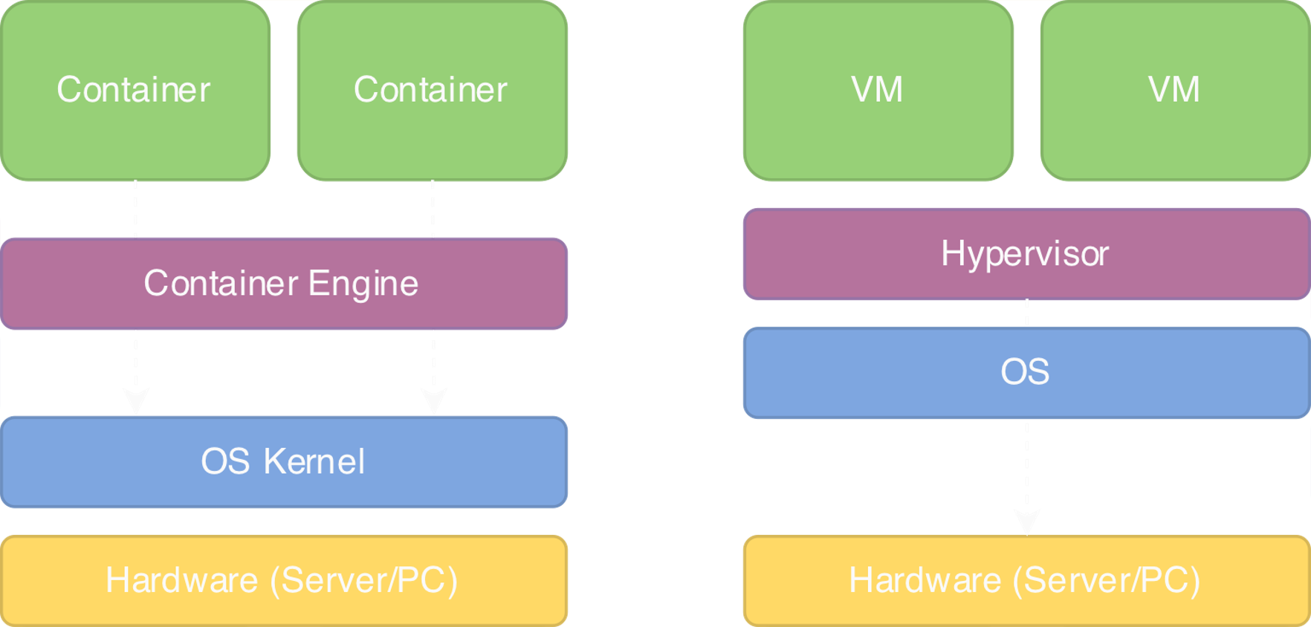
Containerisation

Slide 5

Containerisation
Not a VM*
*easier to think of that way (at least initially)

Slide 6



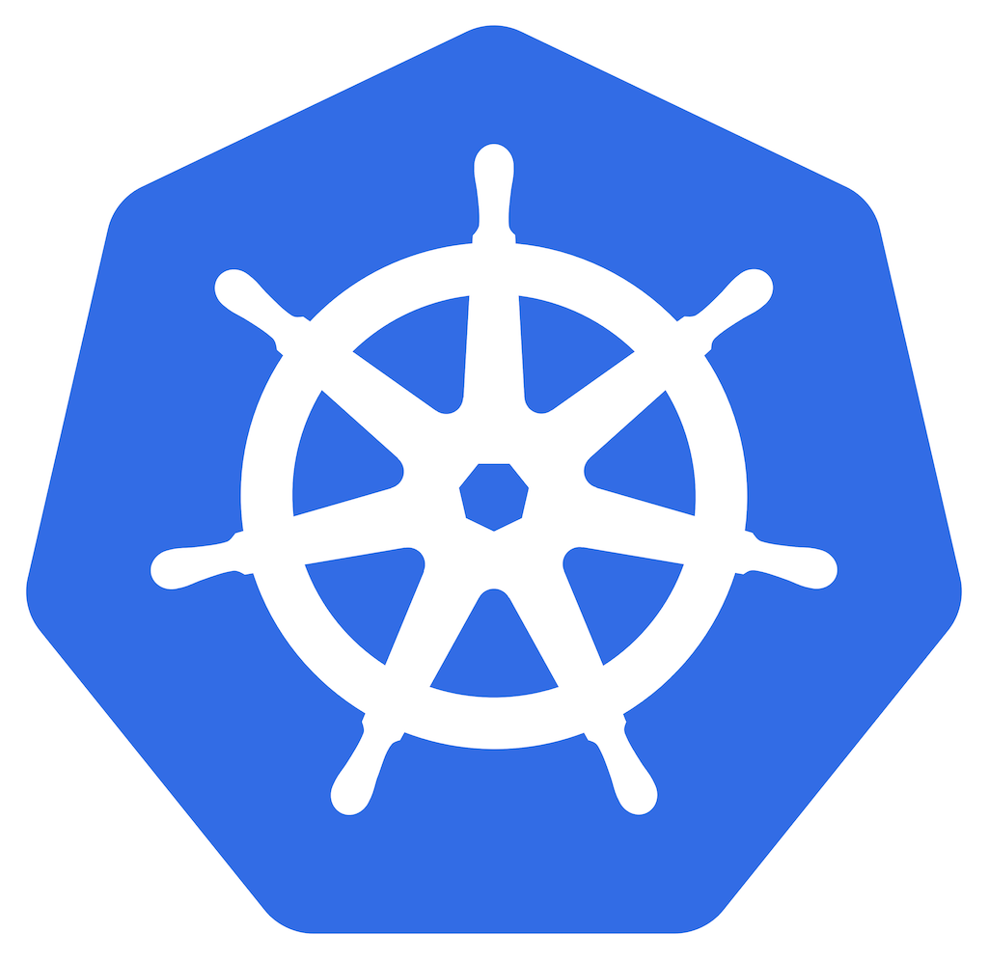
Usage

Slide 7
Why?
Write once, run any where
Version controlled
Open Source
Simple to run
Quick “startup”
Stable and predictable (ephemeral)
Relatively simple to learn
Easy to redeploy

Slide 8
Docker
Coming to an OS near you!
Linux
Windows (including WSL)
MacOS
⚠️ Docker Desktop is NOT free ⚠️

Slide 9
Dockerfile
FROM nginx:1.25.1
COPY html-content /usr/share/nginx/html

Slide 10
Dockerfile
FROM ubuntu:22.04
ENV DEBIAN_FRONTEND=noninteractive
RUN apt update \
&& apt install -y openjdk-11-jdk-headless maven \
&& rm -rf /var/lib/apt/lists/*
RUN mkdir poc
WORKDIR poc
COPY pom.xml .
COPY src/ src/
RUN mvn clean install \
&& mvn dependency:get -Dartifact=org.codehaus.mojo:exec-maven-plugin:3.1.0
CMD mvn -q exec:java -Dexec.mainClass='com.seanwrightsec.poc.PoC'
https://github.com/SeanWrightSec/CVE-2022-42889-PoC/blob/main/Dockerfile

Slide 11
Running Docker Container
docker build –t nginx-example .
docker run --name nginx-example -d -p 8080:80 nginx-example

Slide 12
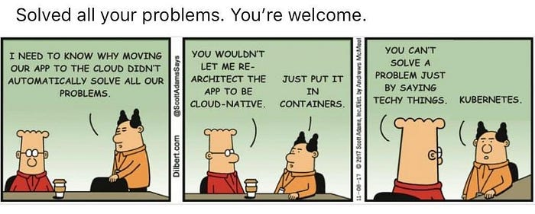
Kubernetes

Slide 13
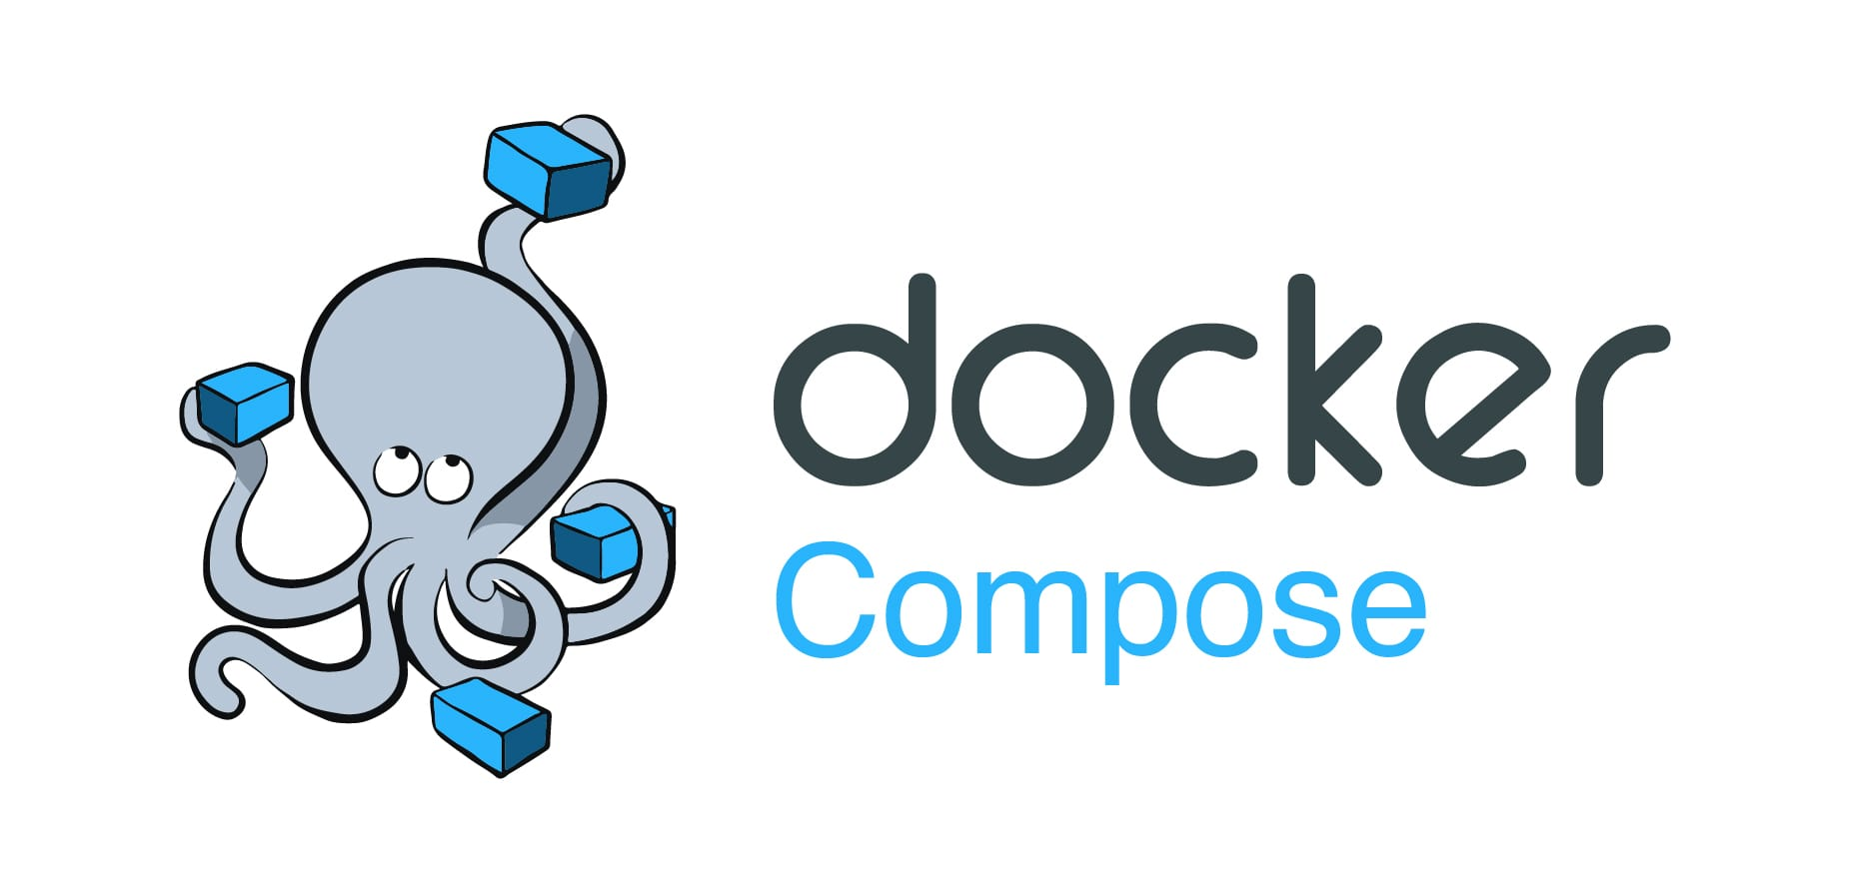
Kubernetes

Slide 14
Docker Compose
https://gist.github.com/SeanWrightSec/bfee677d5b8e6160e9dca1d34fa5c4fe
Dependency Track
Full running instance (with PostgreSQL)

Slide 15

Practical (Security) Use Cases
Case 1: Teaching
Notes:
Teaching

Slide 16

Practical (Security) Use Cases
Case 2: Tooling
Notes:
Teaching

Slide 17

Practical (Security) Use Cases
Case 2-1: Custom Security Tooling
Notes:
Teaching

Slide 18

Practical (Security) Use Cases
Case 2-2: Tooling (DevSecOps)
Notes:
Teaching

Slide 19

Practical (Security) Use Cases
Case 3: Research
Notes:
Teaching

Slide 20
https://github.com/SeanWrightSec/Docker-to-the-Security
Notes:
Teaching

Slide 21
Questions?
Notes:
Teaching

